Slide 1

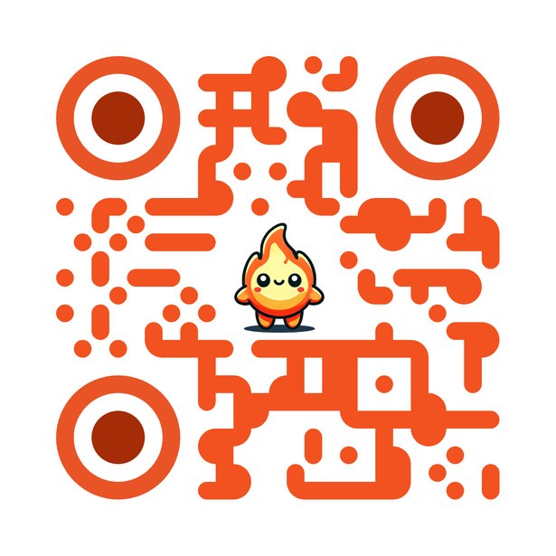

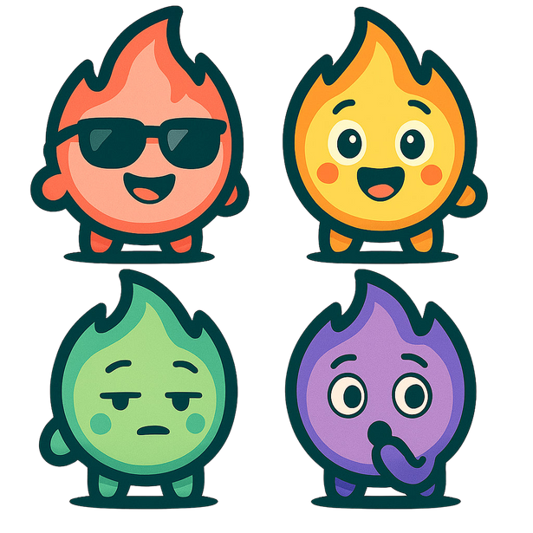

CHIMERA
CHIMERAAPP.NET
THE ALL-IN-ONE MORNING ROUTINE APP THAT BLOCKS DISTRACTIONS, GAMIFIES GOALS, AND HELPS YOU OWN YOUR DAY

Slide 2

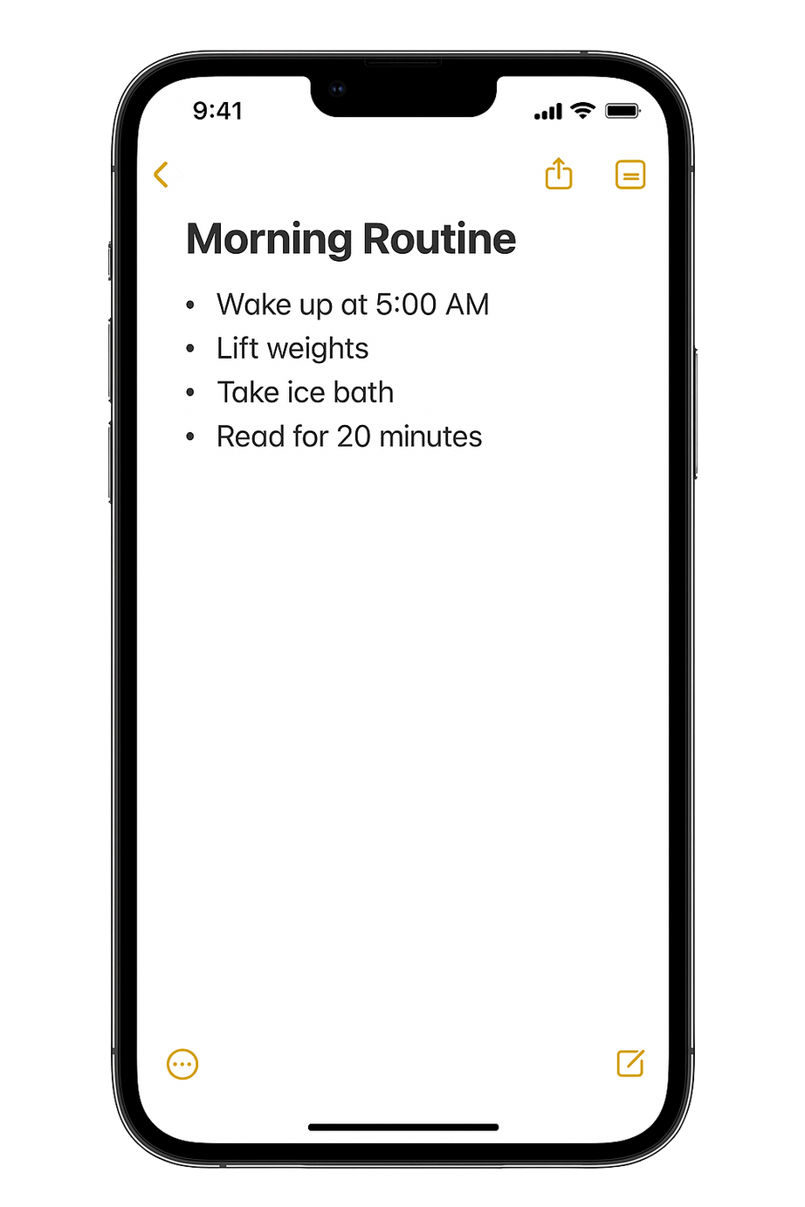

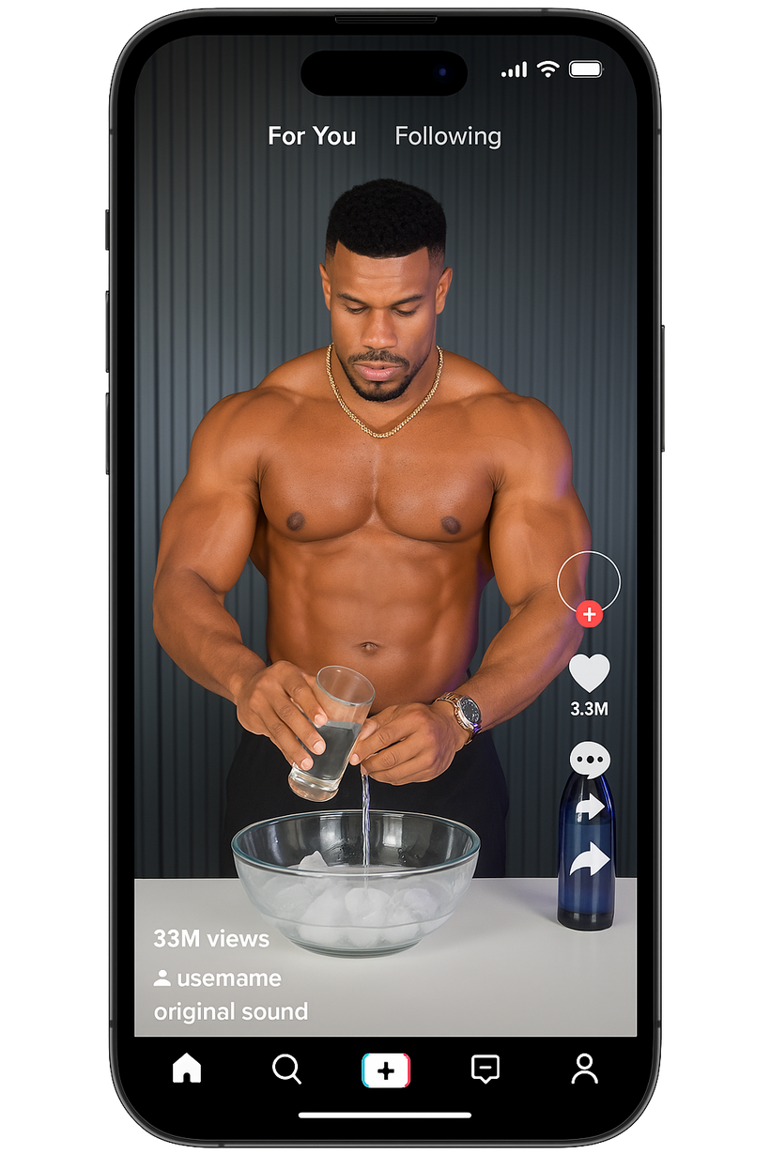
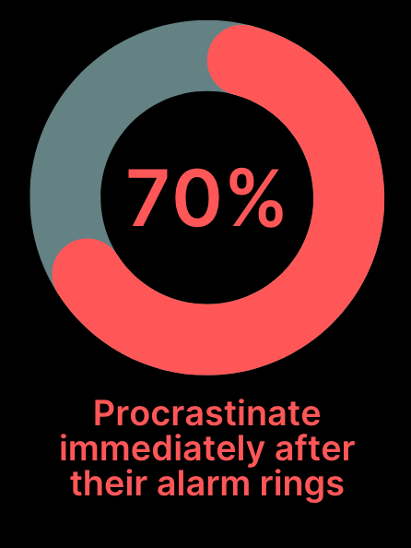
THIS STRUGGLE TO BUILD CONSISTENT MORNING ROUTINES IS A UNIVERSAL CHALLENGE FACED BY YOUTHS

Slide 3
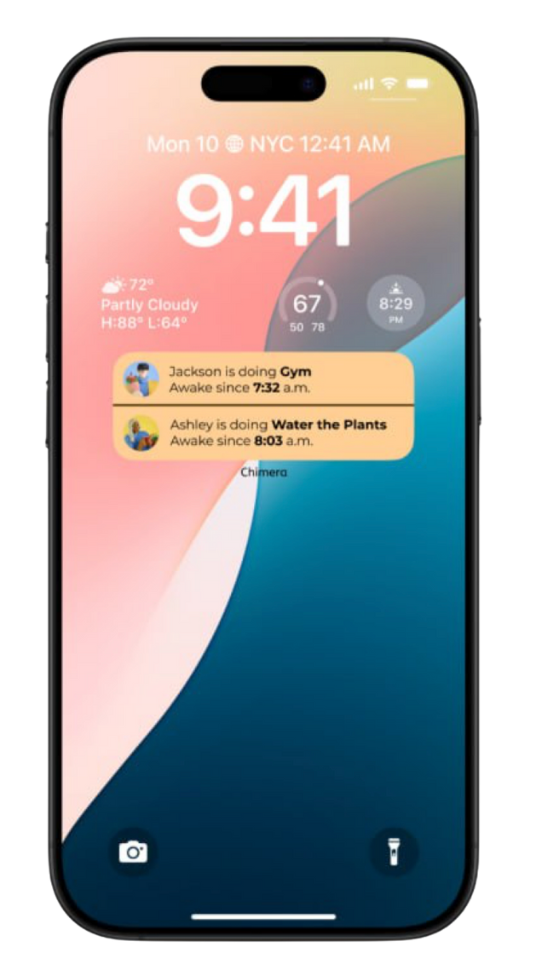
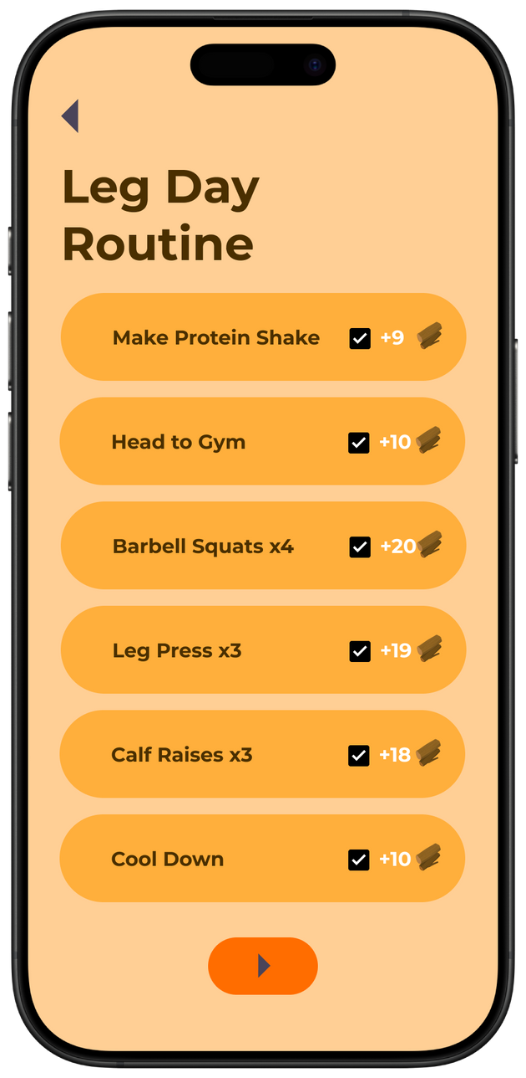
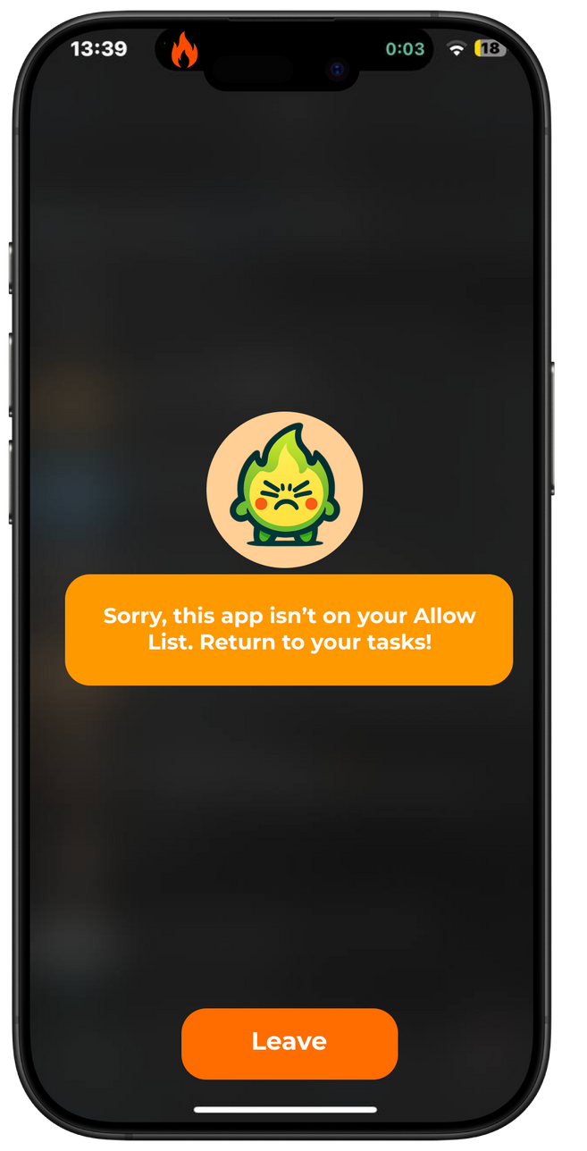
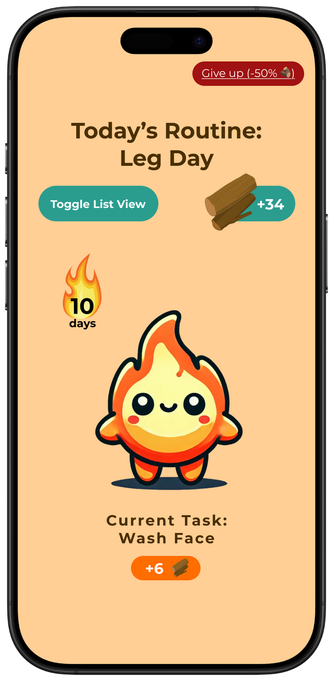
(1) Social Accountability
(2) Distraction Blocking
(3) Gamification

Slide 4
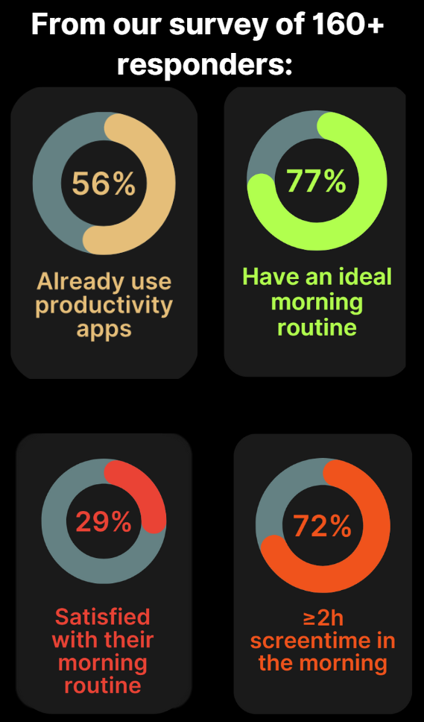
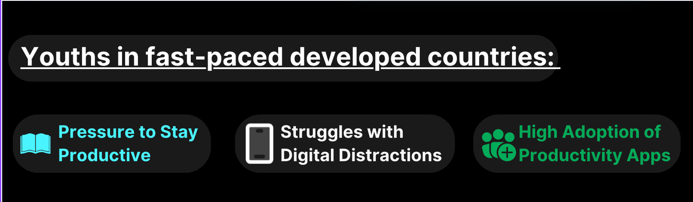
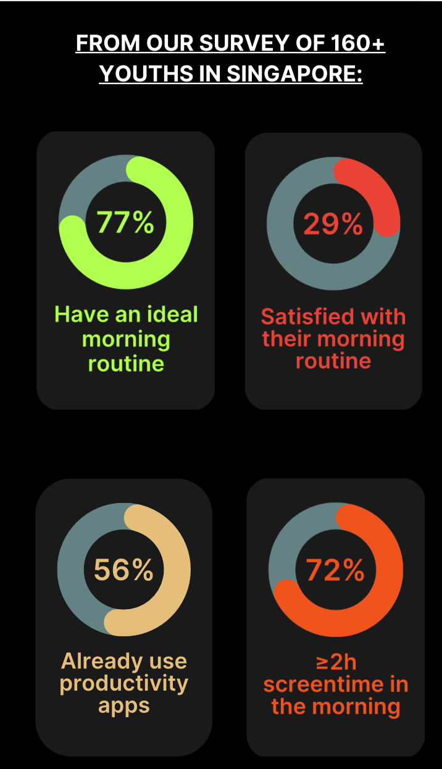
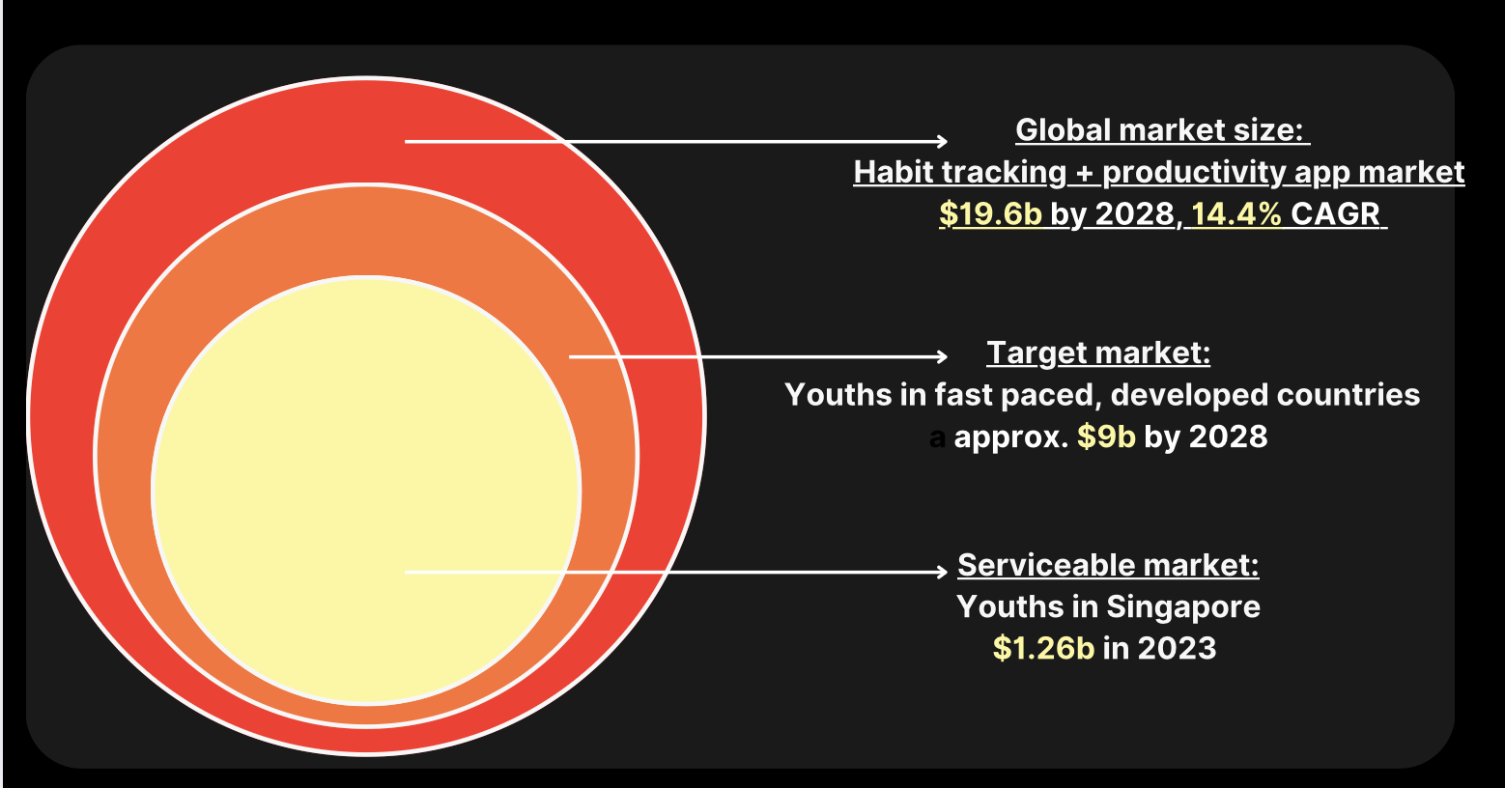

Slide 5





Competitor Analysis
Why morning routine apps fail:
Not enough enforcement, users fail to adhere to routine
AND
Not enough reward for starting, users easily demotivated
Barriers to Entry:
App locking technology for Android system
Building on network effects
CHIMERA
ROUTINERY
FABULOUS
HABITICA
STREAKS

Slide 6




SUMMER
SEM 1 START
AFTER SEM 1
Monetisation Models
B2C
Freemium model: Core app features free, paid subscriptions ($4.99/month) for premium features
In-app purchases: Cosmetics, “freeze” streaks
B2B/G
Integrate with hobby platforms
Government health initiatives
MVP Launch
Beta Launch
Growth
Launch within RC4
Improve on UI/UX, basic features
Build a waitlist of committed early adopters
Obtain funding from NUS accelerator programs
Start monetisation
Scale on marketing
AI-personalised routines
Additional content
Target B2G/B markets
Develop Core Features
Leverage NOC MY startup ecosystem for mentorship, validation, iteration
Build Branding and Presence
Notes:
Launch to closed group of students
Collect feedback on engagement and usability
Improvements to features, UI/UX
Build a loyal early community
Obtain funding from NUS accelerator programs (BLK71, VIP, The Furnace)

Slide 7
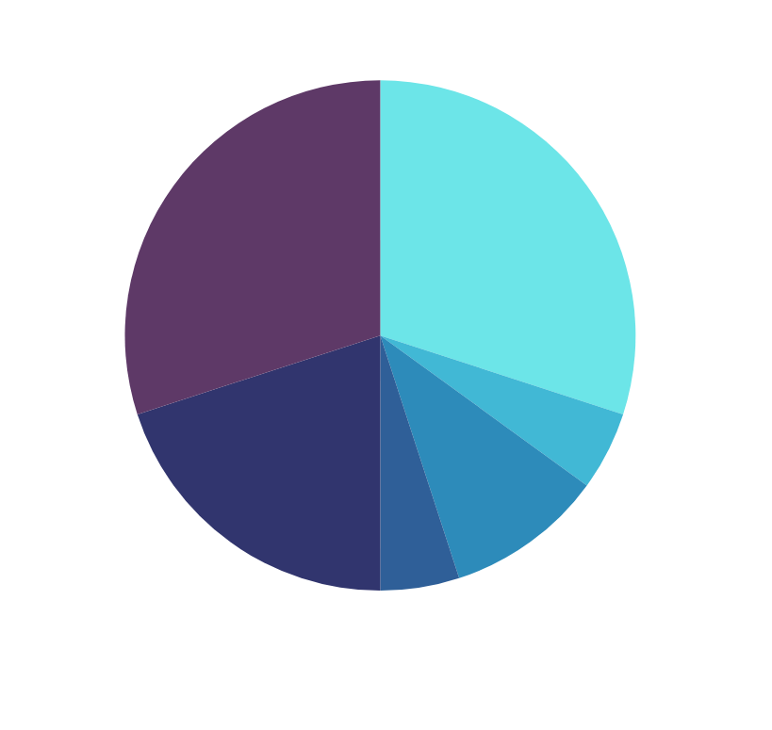
Reserves | $3000 | Unforseen costs
Interns | $3000 | 2 Interns X $500/Month X 3 Months (when needed)
Testing | $500 | $50 x 10 testers for 2 months
Operational Costs | $1000 | Server Costs: $500 API Costs: $250 Domain Costs: $100 Misc Costs: $150
Consulting | $500 | Legal, Finance, Accounting
Marketing | $2000 | Sponsorships: Singaporean Student Influencers Advertisements: App Store, Instagram Ads
10k Funds

Slide 8

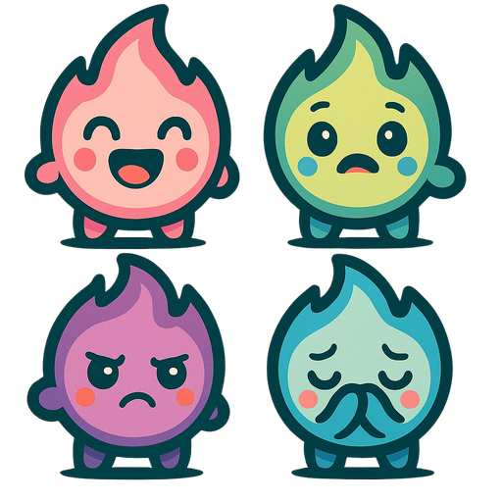
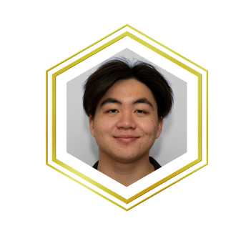
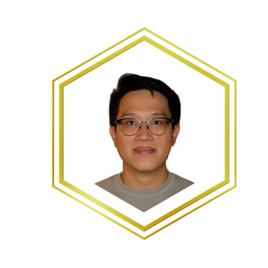
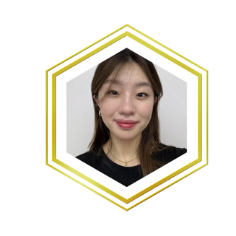

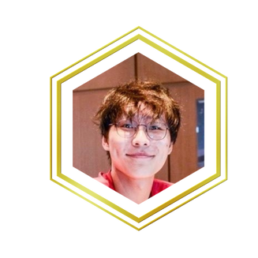
Supported under
NES Startup
Membership
JAVIER
ZERUI
SHI HUI
CELINE
KENNETH
CO-FOUNDER, SOC
6 MONTH INTERN @ STARTUP (YC S21, FORBES 30 UNDER 30 ASIA)
NOC MALAYSIA
IDP
CO-FOUNDER, CDE
7 MONTH INTERN @ STARTUP
NOC MALAYSIA
BUSINESS DEVELOPMENT LEAD, BIZ
UI/UX + MARKETING LEAD, SOC
3 MONTH INTERN @ STARTUP
HACX 2024 SEMIFINALIST
TECH LEAD, CDE
FOUNDING SWE @ CHECK (ITERATIVE)
6 MONTH INTERN @ NODEFLAIR

Slide 9
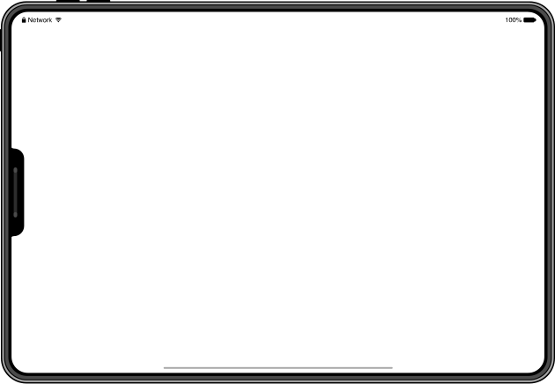
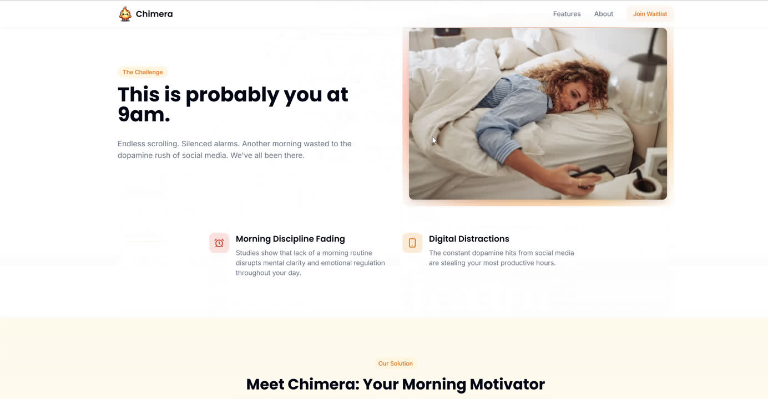
Q & A
JOIN OUR WAITLIST: CHIMERAAPP.NET

